Slide 1

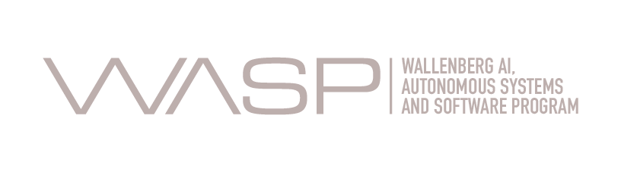

Automatic Software Debloating
Ph.D. Proposal (80%) Seminar
César Soto Valero
Supervised by: Thomas Durieux, Martin Monperrus, and Benoit Baudry
KTH Royal Institute of Technology

Slide 2
Agenda
Background
Debloating Java dependencies (static analysis)
Debloating Java bytecode (dynamic analysis)
Lessons learned
Conclusion
Future work
2
Notes:
Let’s say that we have a project P.
In the pom.xml we declare three dependencies, A, B, and C. These are direct dependencies of project P.
But the dependency A also has other dependencies, D and E, and dependency C has a depenency F. D, E, and F are called transitive dependencies of project P.
On the other hand, this project P declares the module Q as his parent, and Q declares a direct dependency G. So, in this context G becomes an inherited dependency of project P.
In summary, we can distinguish three types of dependencies in the dependency tree of P: direct dependencies, transitive dependencies, and inherited dependencies.
2

Slide 3
Part #1: Background
[ Software bloat]
3
Notes:
3

Slide 4
“Software tends to grow over time, whether or not there's a need for it.”
Gerard J. Holzmann. (2015). Code Inflation. IEEE Software, 32 (2).
4
Notes:
Let’s say that we have a project P.
In the pom.xml we declare three dependencies, A, B, and C. These are direct dependencies of project P.
But the dependency A also has other dependencies, D and E, and dependency C has a depenency F. D, E, and F are called transitive dependencies of project P.
On the other hand, this project P declares the module Q as his parent, and Q declares a direct dependency G. So, in this context G becomes an inherited dependency of project P.
In summary, we can distinguish three types of dependencies in the dependency tree of P: direct dependencies, transitive dependencies, and inherited dependencies.
4

Slide 5
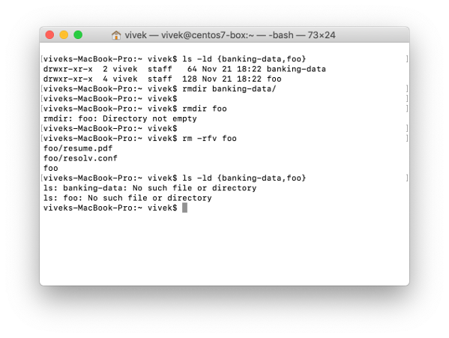


Software bloat
Maintenance
Security
Performance
“The term software bloat refers to code that is packaged in an application but that is not necessary for building and running the application.”
Size
[USENIX] RAZOR : A Framework for Post-deployment Software Debloating
[USENIX] Is Less Really More? Quantifying the Security Benefits of Debloating Web Applications
[CCS] Slimium: Debloating the Chromium Browser with Feature Subsetting
[TSE] TRIMMER: An Automated System for Configuration-based Software Debloating
[USENIX] Debloating Software through Piece-Wise Compilation and Loading
Notes:
Software bloat is code that is packaged in an application but is actually not necessary to build and run the application.
The existence of software bloat is a problem because it needlessly wastes developers’ time and resources.
For example, software bloat increases the size of software artifacts, creates maintenance issues, affects performance, and compromises security.
Let’s me show you an example that illustrates the problem of software bloat.

Slide 6
Part #2: Debloating Java dependencies
[ Static analysis ]
6
Notes:
Let’s say that we have a project P.
In the pom.xml we declare three dependencies, A, B, and C. These are direct dependencies of project P.
But the dependency A also has other dependencies, D and E, and dependency C has a depenency F. D, E, and F are called transitive dependencies of project P.
On the other hand, this project P declares the module Q as his parent, and Q declares a direct dependency G. So, in this context G becomes an inherited dependency of project P.
In summary, we can distinguish three types of dependencies in the dependency tree of P: direct dependencies, transitive dependencies, and inherited dependencies.
6

Slide 7

Source code
import com.google.common.base.Joiner; import org.apache.spark.annotation.Private; @Private public class EnumUtil { public static <E extends Enum<E>> E parseIgnoreCase(Class<E> clz, String str) { E[] constants = clz.getEnumConstants(); if (str == null) { return null; } for (E e : constants) { if (e.name().equalsIgnoreCase(str)) { return e; } } throw new IllegalArgumentException( String.format("Illegal type='%s'. Supported type values: %s", str, Joiner.on(", ").join(constants))); } }
7
core/src/main/java/org/apache/spark/util/EnumUtil.java
Notes:
If we forget about the dependency tree structure for a moment and look at the bytecode calls made by the project P, we can see that there is a set of instructions in P that call another set of instructions in the dependency A. And this set of instructions in A calls another subset of the transitive dependency D.
Interestingly, we can also see that the depency F is is used by a subset of P.
So, in this context, the dependency tree of P is still the same but there are dependencies that are not needed.
P doesn’t need B, it does’t need C, E, or G.
We call these bloated dependencies, and we believe that they should be removed.
7

Slide 8
Bytecode
// class version 52.0 (52)
// access flags 0x21
public class org/apache/spark/util/EnumUtil {
// compiled from: EnumUtil.java
// access flags 0x9
// signature <E:Ljava/lang/Enum<TE;>;>(Ljava/lang/Class<TE;>;Ljava/lang/String;)TE;
// declaration: E parseIgnoreCase<E extends java.lang.Enum<E>>(java.lang.Class<E>, java.lang.String)
public static parseIgnoreCase(Ljava/lang/Class;Ljava/lang/String;)Ljava/lang/Enum;
. . .
L9
LINENUMBER 35 L9
INVOKESTATIC com/google/common/base/Joiner.on (Ljava/lang/String;)Lcom/google/common/base/Joiner;
ALOAD 2
INVOKEVIRTUAL com/google/common/base/Joiner.join ([Ljava/lang/Object;)Ljava/lang/String;
AASTORE
. . .
8
target/classes/org/apache/spark/util/EnumUtil.class
Notes:
If we forget about the dependency tree structure for a moment and look at the bytecode calls made by the project P, we can see that there is a set of instructions in P that call another set of instructions in the dependency A. And this set of instructions in A calls another subset of the transitive dependency D.
Interestingly, we can also see that the depency F is is used by a subset of P.
So, in this context, the dependency tree of P is still the same but there are dependencies that are not needed.
P doesn’t need B, it does’t need C, E, or G.
We call these bloated dependencies, and we believe that they should be removed.
8

Slide 9

Bytecode
. . .
// access flags 0x9
public static on(Ljava/lang/String;)Lcom/google/common/base/Joiner;
L0
LINENUMBER 71 L0
NEW com/google/common/base/Joiner
DUP
ALOAD 0
INVOKESPECIAL com/google/common/base/Joiner.<init> (Ljava/lang/String;)V
ARETURN
. . .
// access flags 0x11
// signature (Ljava/lang/Iterable<*>;)Ljava/lang/String;
// declaration: java.lang.String join(java.lang.Iterable<?>)
public final join(Ljava/lang/Iterable;)Ljava/lang/String;
L0
LINENUMBER 230 L0
ALOAD 0
ALOAD 1
INVOKEINTERFACE java/lang/Iterable.iterator ()Ljava/util/Iterator; (itf)
INVOKEVIRTUAL com/google/common/base/Joiner.join (Ljava/util/Iterator;)Ljava/lang/String;
ARETURN
. . .
9
Notes:
If we forget about the dependency tree structure for a moment and look at the bytecode calls made by the project P, we can see that there is a set of instructions in P that call another set of instructions in the dependency A. And this set of instructions in A calls another subset of the transitive dependency D.
Interestingly, we can also see that the depency F is is used by a subset of P.
So, in this context, the dependency tree of P is still the same but there are dependencies that are not needed.
P doesn’t need B, it does’t need C, E, or G.
We call these bloated dependencies, and we believe that they should be removed.
9

Slide 10
Dependency tree
P
10
Notes:
Let’s say that we have a project P.
In the pom.xml we declare three dependencies, A, B, and C. These are direct dependencies of project P.
But the dependency A also has other dependencies, D and E, and dependency C has a depenency F. D, E, and F are called transitive dependencies of project P.
On the other hand, this project P declares the module Q as his parent, and Q declares a direct dependency G. So, in this context G becomes an inherited dependency of project P.
In summary, we can distinguish three types of dependencies in the dependency tree of P: direct dependencies, transitive dependencies, and inherited dependencies.
10

Slide 11
Dependency tree
<parent> <groupId>org.Q</groupId> <artifactId>Q</artifactId> </parent>
Q
P
G
11
Notes:
Let’s say that we have a project P.
In the pom.xml we declare three dependencies, A, B, and C. These are direct dependencies of project P.
But the dependency A also has other dependencies, D and E, and dependency C has a depenency F. D, E, and F are called transitive dependencies of project P.
On the other hand, this project P declares the module Q as his parent, and Q declares a direct dependency G. So, in this context G becomes an inherited dependency of project P.
In summary, we can distinguish three types of dependencies in the dependency tree of P: direct dependencies, transitive dependencies, and inherited dependencies.
11

Slide 12
Dependency tree
Q
P
G
<dependency> <groupId>org.A</groupId> <artifactId>A</artifactId> </dependency>
<dependency> <groupId>org.B</groupId> <artifactId>B</artifactId> </dependency>
<dependency> <groupId>org.C</groupId> <artifactId>C</artifactId> </dependency>
A
B
C
12
Notes:
Let’s say that we have a project P.
In the pom.xml we declare three dependencies, A, B, and C. These are direct dependencies of project P.
But the dependency A also has other dependencies, D and E, and dependency C has a depenency F. D, E, and F are called transitive dependencies of project P.
On the other hand, this project P declares the module Q as his parent, and Q declares a direct dependency G. So, in this context G becomes an inherited dependency of project P.
In summary, we can distinguish three types of dependencies in the dependency tree of P: direct dependencies, transitive dependencies, and inherited dependencies.
12

Slide 13
Dependency tree
Q
P
G
A
B
C
D
E
F
13
Notes:
Let’s say that we have a project P.
In the pom.xml we declare three dependencies, A, B, and C. These are direct dependencies of project P.
But the dependency A also has other dependencies, D and E, and dependency C has a depenency F. D, E, and F are called transitive dependencies of project P.
On the other hand, this project P declares the module Q as his parent, and Q declares a direct dependency G. So, in this context G becomes an inherited dependency of project P.
In summary, we can distinguish three types of dependencies in the dependency tree of P: direct dependencies, transitive dependencies, and inherited dependencies.
13

Slide 14
Dependency tree
Q
Inherited dependency
P
G
Direct dependencies
A
B
C
Transitive dependencies
D
E
F
14
Notes:
Let’s say that we have a project P.
In the pom.xml we declare three dependencies, A, B, and C. These are direct dependencies of project P.
But the dependency A also has other dependencies, D and E, and dependency C has a depenency F. D, E, and F are called transitive dependencies of project P.
On the other hand, this project P declares the module Q as his parent, and Q declares a direct dependency G. So, in this context G becomes an inherited dependency of project P.
In summary, we can distinguish three types of dependencies in the dependency tree of P: direct dependencies, transitive dependencies, and inherited dependencies.
14

Slide 15
Bytecode analysis
Q
P
G
A
B
C
D
E
F
15
Notes:
If we forget about the dependency tree structure for a moment and look at the bytecode calls made by the project P, we can see that there is a set of instructions in P that call another set of instructions in the dependency A. And this set of instructions in A calls another subset of the transitive dependency D.
Interestingly, we can also see that the depency F is is used by a subset of P.
So, in this context, the dependency tree of P is still the same but there are dependencies that are not needed.
P doesn’t need B, it does’t need C, E, or G.
We call these bloated dependencies, and we believe that they should be removed.
15

Slide 16
Debloating direct dependencies
Q
P
G
A
B
C
- <dependency> - <groupId>org.B</groupId> - <artifactId>B</artifactId> - </dependency>
- <dependency> - <groupId>org.C</groupId> - <artifactId>C</artifactId> - </dependency>
D
E
F
16
Notes:
So, coming back to our example.
DepClean starts by looking at the part of the code in P that calls third-party dependencies.
In this example, there are two sets in P, one of them uses a subset of the dependency A, and the other uses a subset of the dependency F.
And, as we can see, the project P doesn’t use the direct dependencies B and C, so we can remove these dependencies from P.
- To do so, we just need to remove a couple of entries in the dependencies declaration of the pom file of P.
16

Slide 17
Debloating transitive dependencies
Q
P
G
A
<dependency> <groupId>org.A</groupId> <artifactId>A</artifactId>
+ <exclusions> + <exclusion> + <groupId>org.E</groupId> + <artifactId>E</artifactId> + </exclusion> + </exclusions> </dependency>
D
E
F
17
Notes:
Now, we can see that the part of A that is used by P, calls some instructions of the dependency D.
But it doesn’t call any API member of E.
So, in the context of the project P, which is the one that we are analyzing, the transitive dependency D is used, while the transitive dependency E is bloated.
Notice that maybe A uses E. However, in the context of the project P, E is not used because it doesn’t exist any bytecode call to E in the part of A that is used by P.
- This way, E can be safely excluded from A in the pom, which means that it will no longer be part of the dependency tree of P
17

Slide 18
Debloating inherited dependencies
Q
P
G
A
- <parent> - <groupId>org.Q</groupId> - <artifactId>Q</artifactId> - </parent>
D
F
18
Notes:
Now, we can see that the part of A that is used by P, calls some instructions of the dependency D.
But it doesn’t call any API member of E.
So, in the context of the project P, which is the one that we are analyzing, the transitive dependency D is used, while the transitive dependency E is bloated.
Notice that maybe A uses E. However, in the context of the project P, E is not used because it doesn’t exist any bytecode call to E in the part of A that is used by P.
- This way, E can be safely excluded from A in the pom, which means that it will no longer be part of the dependency tree of P
18

Slide 19
Debloating inherited dependencies
P
A
D
F
19
Notes:
Now, we can see that the part of A that is used by P, calls some instructions of the dependency D.
But it doesn’t call any API member of E.
So, in the context of the project P, which is the one that we are analyzing, the transitive dependency D is used, while the transitive dependency E is bloated.
Notice that maybe A uses E. However, in the context of the project P, E is not used because it doesn’t exist any bytecode call to E in the part of A that is used by P.
- This way, E can be safely excluded from A in the pom, which means that it will no longer be part of the dependency tree of P
19

Slide 20
Debloated dependency tree
P
A
F
D
20
Notes:
And the debloat result of using DepClean is an smaller dependency tree
20

Slide 21
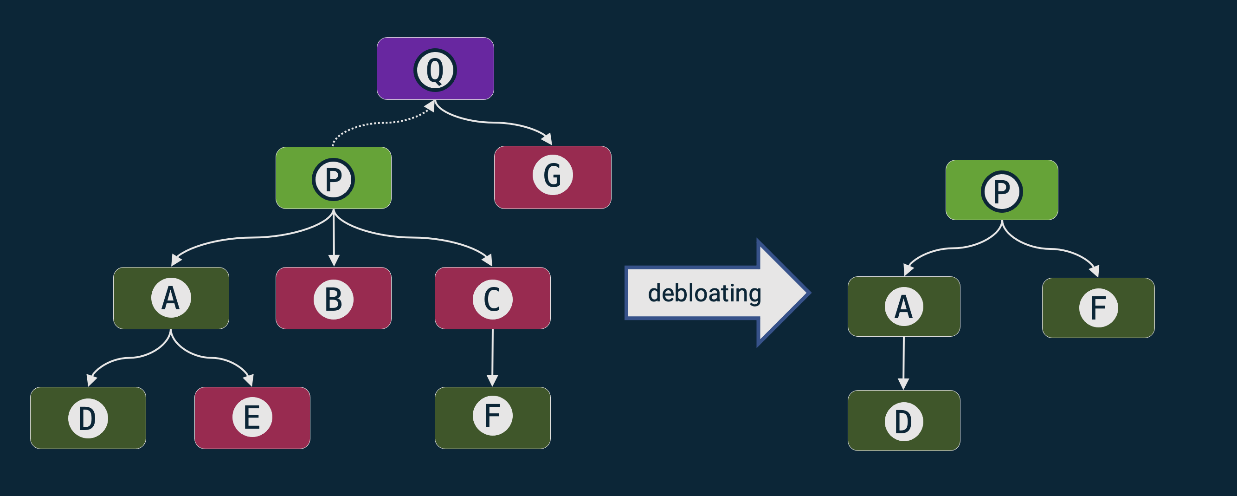
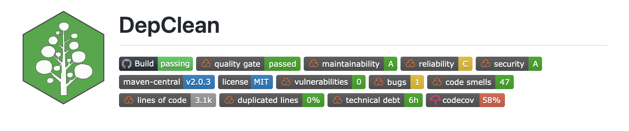

DepClean
Detect and report bloated dependencies:
In the context of an artifact.
On the whole dependency tree.
Automatic generation of a debloated pom.xml file.
Open source (https://github.com/castor-software/depclean).
21
Notes:
To do so, we developed DepClean.
- It detects and reports bloated dependencies to developers.
- DepClean works in the context of a Maven artifact, so, given an artifact, it analyzes its whole dependency tree and produces a report with information about the usage status of each dependency. These are two unique features of DepClean. There is a Maven plugin called the maven-dependency-analyzer that provides a report about the status of usage status of dependencies, but it doesn’t analyze transitive dependencies in the context of our project and doesn’t distinguish between transitive and inherited dependencies.
-Another important feature of DepClean is that it produces an alternative pom.xml file with all the bloated dependencies removed. So, developers can use this pom file directly in their projects.
-And DepClean is open source and publicly available on GitHub.
21

Slide 22
RQ: How much dependency bloat
exists out there?
22
Notes:
Having DepClean in our toolset, one question arises immediately.
How much dependency bloat exists out there, in the wild? In the whole Maven ecosystem.
22

Slide 23
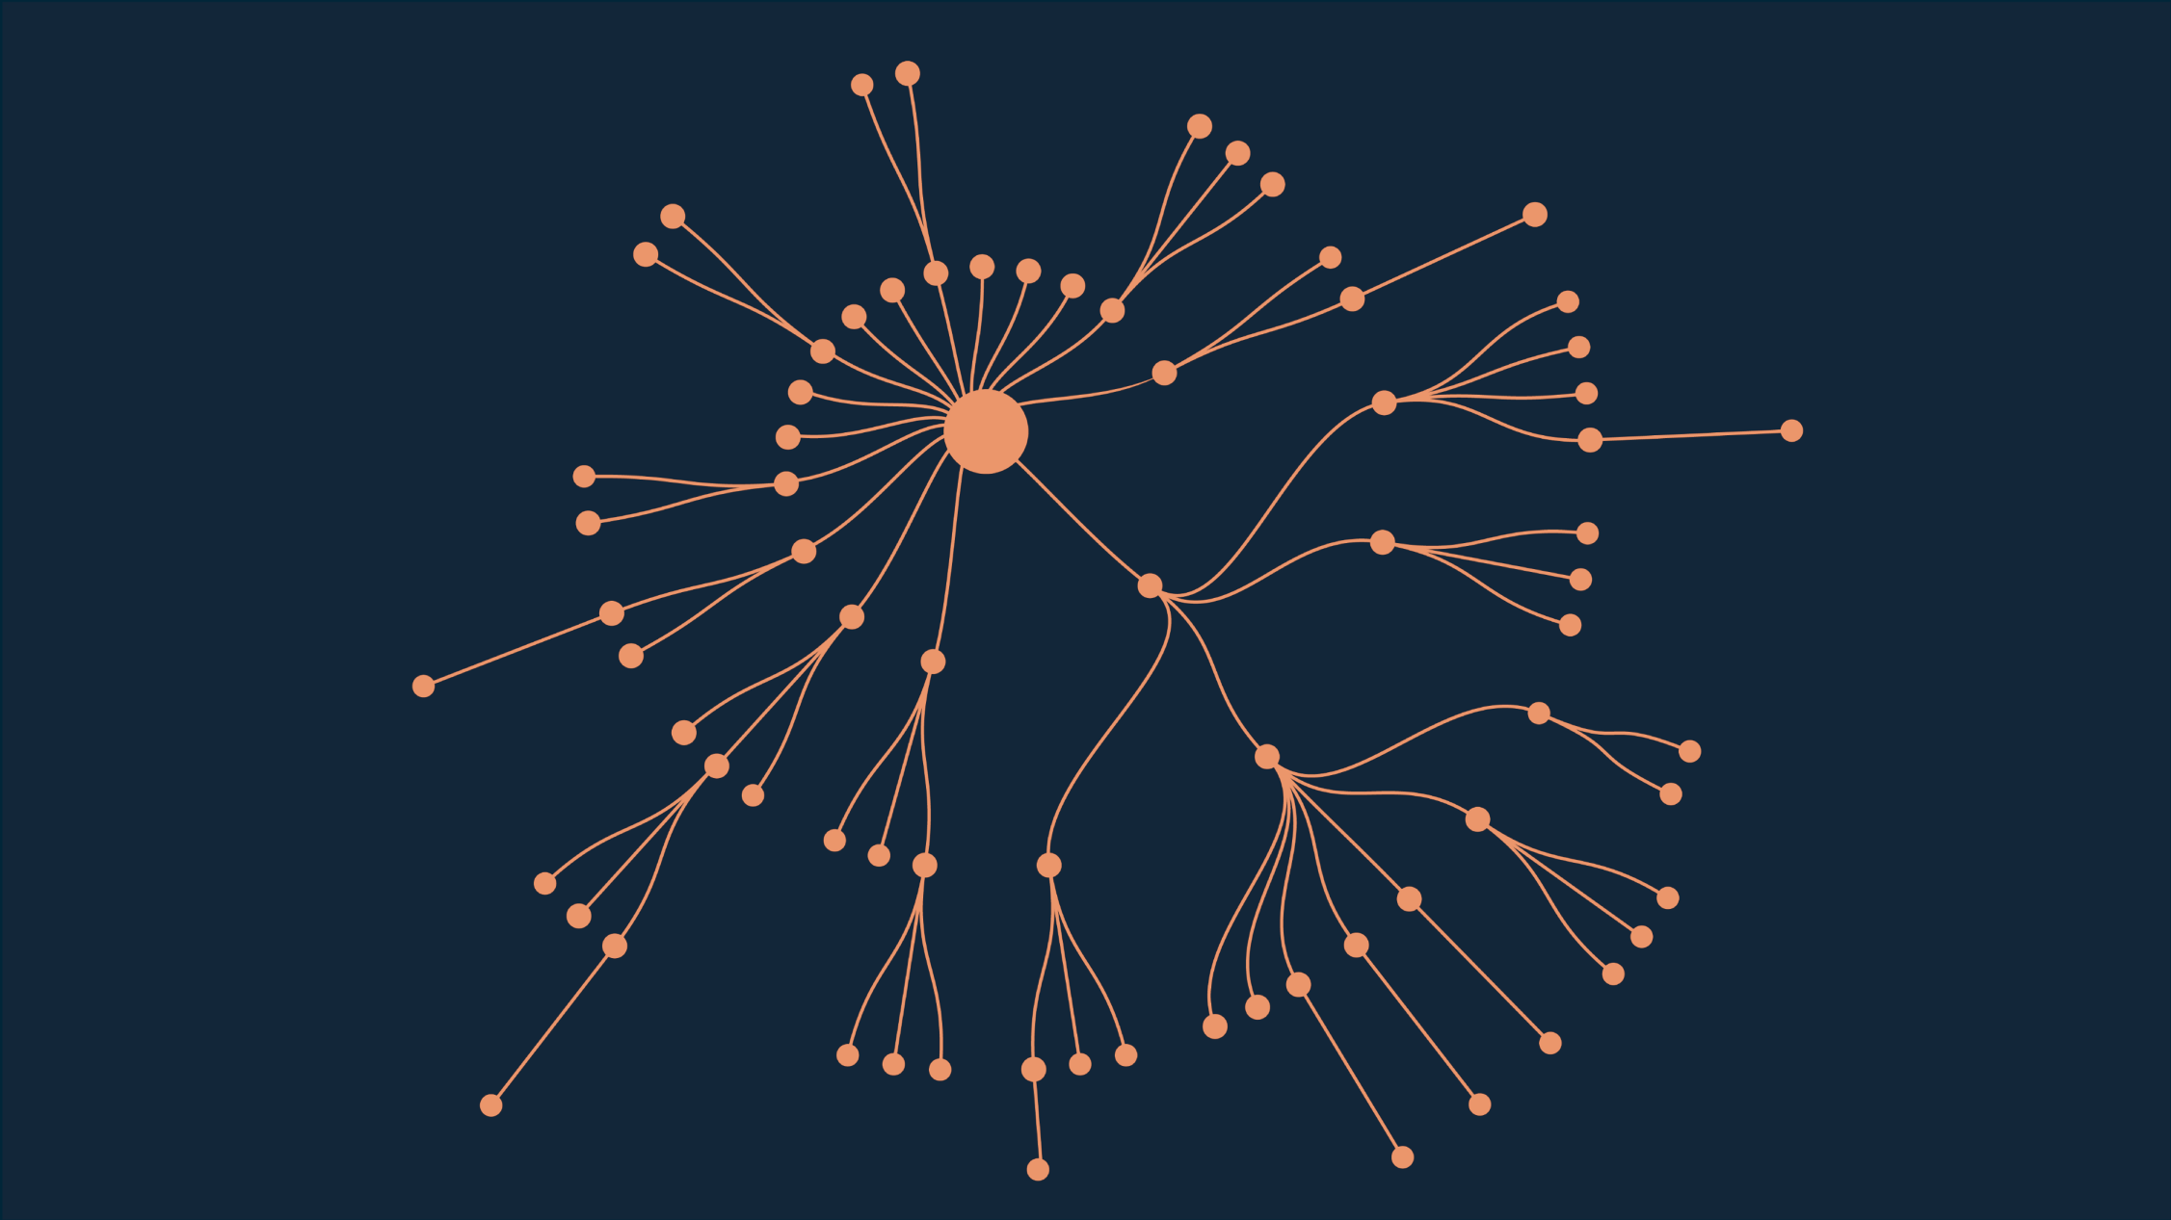
Example: Spoon library
Open source library for code analysis, 75 dependencies.
https://github.com/INRIA/spoon
23
Notes:
Let’s see a real example.
This is the dependency tree of Spoon, a library for metaprogramming and source code analysis.
It contains a total of 75 dependencies.
As we can observe, there are both direct and transitive dependencies.
23

Slide 24
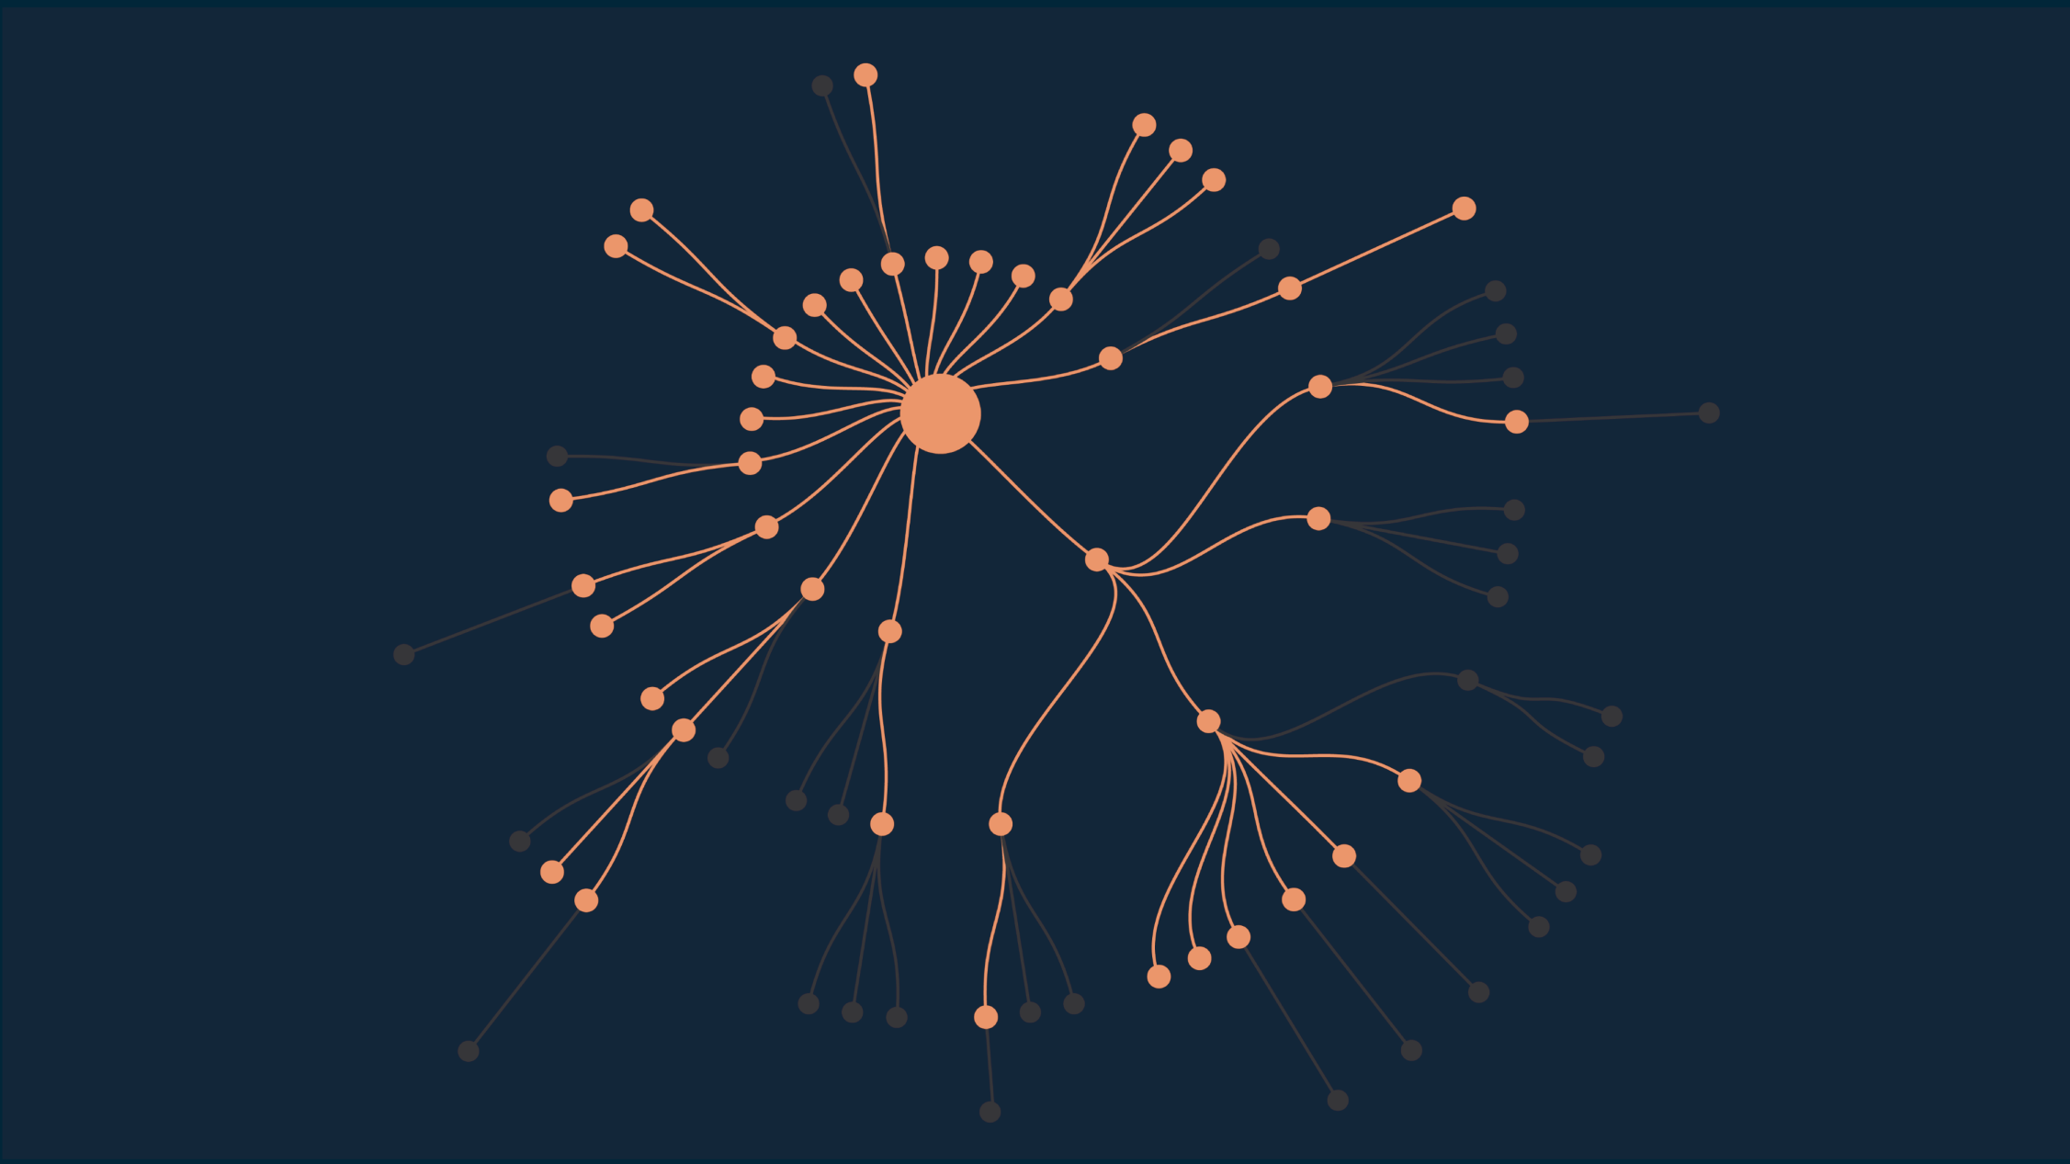
Regular Maven analysis
Maven excludes
31 redundant dependencies.
https://github.com/INRIA/spoon
24
Notes:
Maven, as part of its analysis, excludes a total of 31 dependencies from its dependency tree.
These are redundant dependencies, which basically means that they are duplicated versions of the same provider.
24

Slide 25
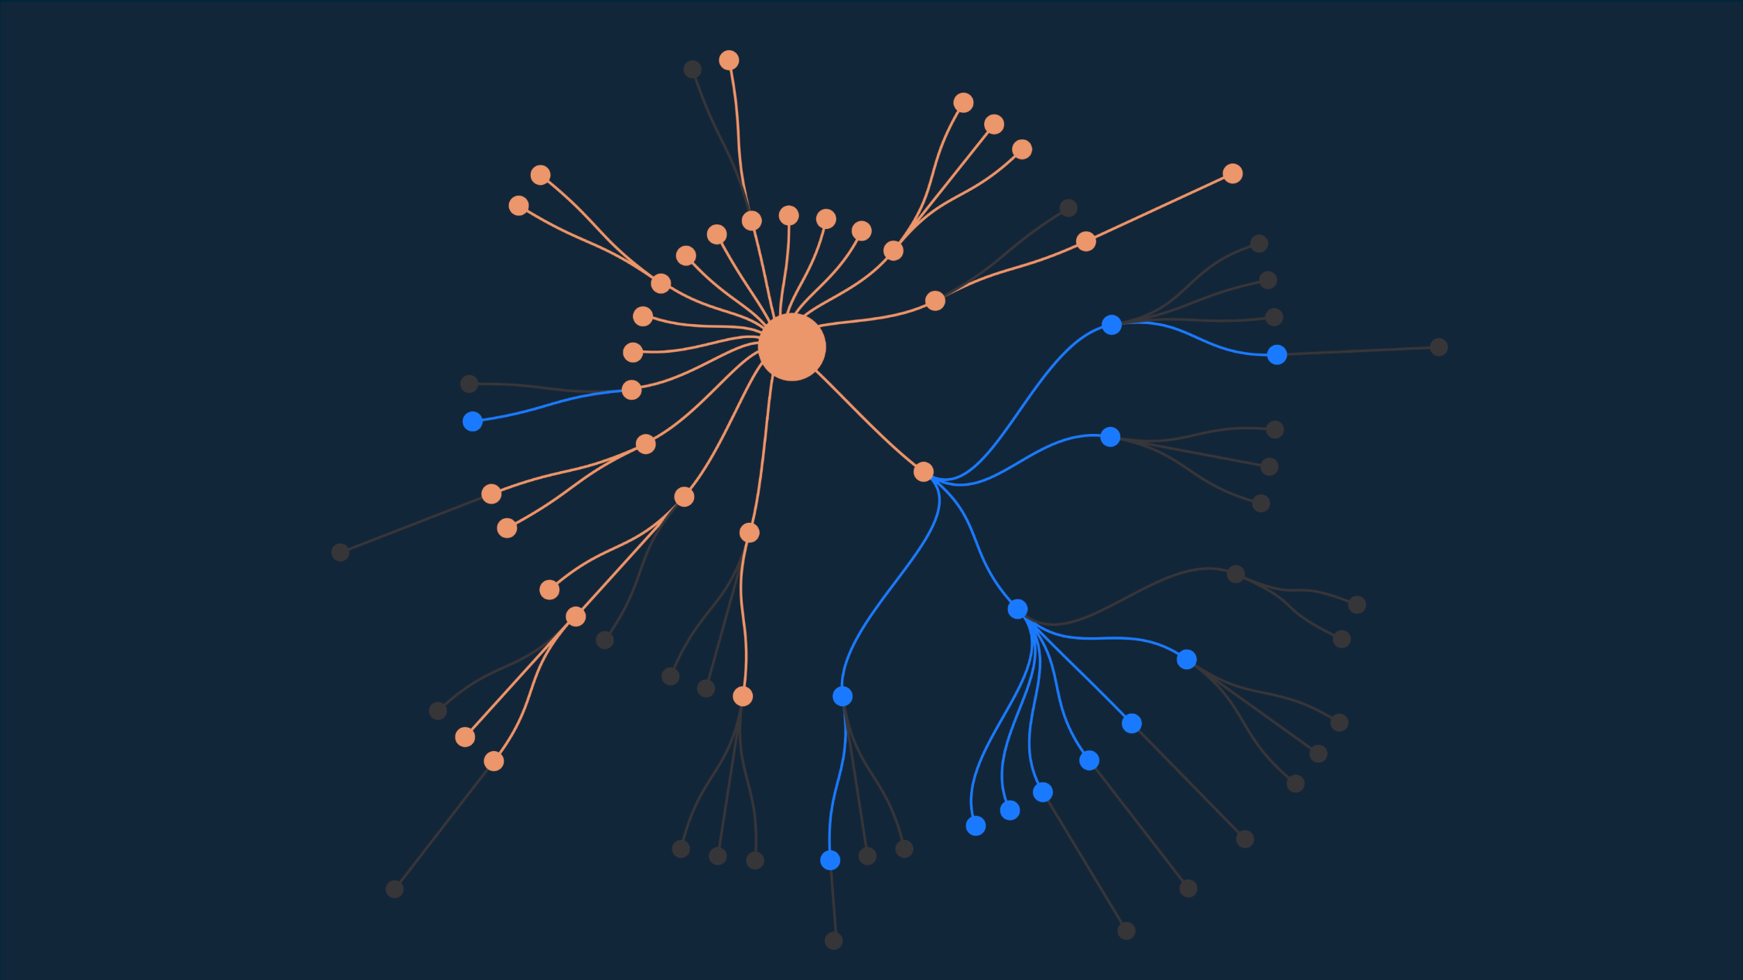
DepClean novel analysis
DepClean detects
13 bloated dependencies.
https://github.com/INRIA/spoon
25
Notes:
After this, DepClean performs its novel dependency analysis.
It detects 13 bloated transitive dependencies in Spoon.
25

Slide 26
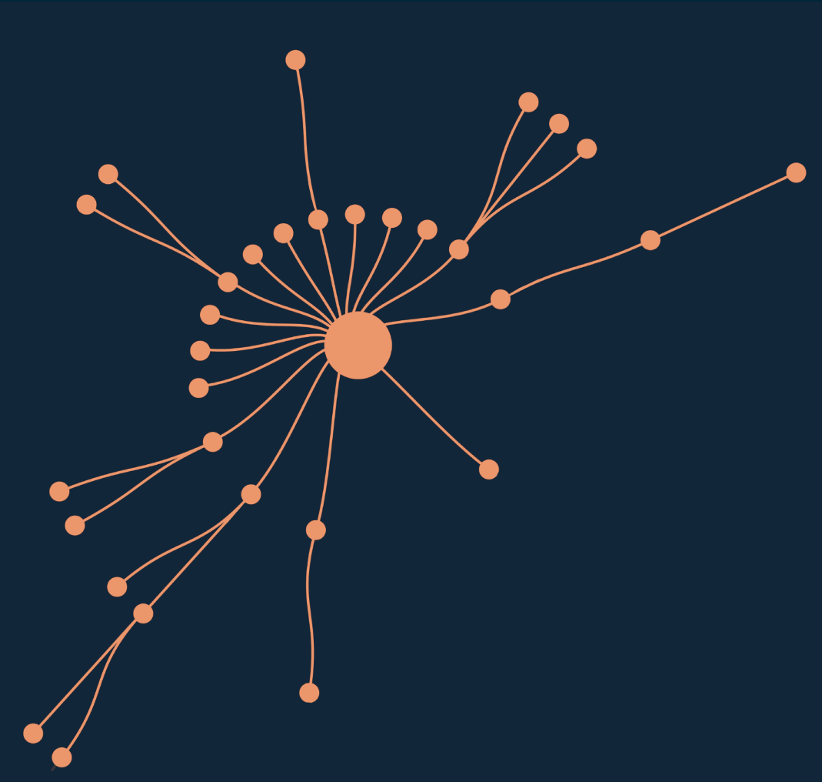
Debloated Spoon library
debloat
 | JAR Size | #Classes
Before | 16.2 Mb | 7 425
After | 12.7 Mb | 5 593
Reduction | 28% | 25%
https://github.com/INRIA/spoon/pull/3167
26
Notes:
So basically, we can use DepClean to transform this dependency tree.
We debloat it, remove all the unused dependencies, and obtain a much smaller version of it. And it is important to say that process doesn’t affect the build of Spoon. It will compile, the tests will be executed, and all the rest of the Maven phases will work as normal.
-Which is more important, the removal of these bloated dependencies has a very positive impact on the size and the number of classes of the library. The jar-with-dependencies of the Spoon is reduced, from 16.2MB to 12.7MB, which represents a significant reduction in size on disk of 27.6%, and a 24.7% of reduction in the number of classes.
This is the impact of using DepClean on Spoon, but, what about the whole Maven ecosystem?
26

Slide 27
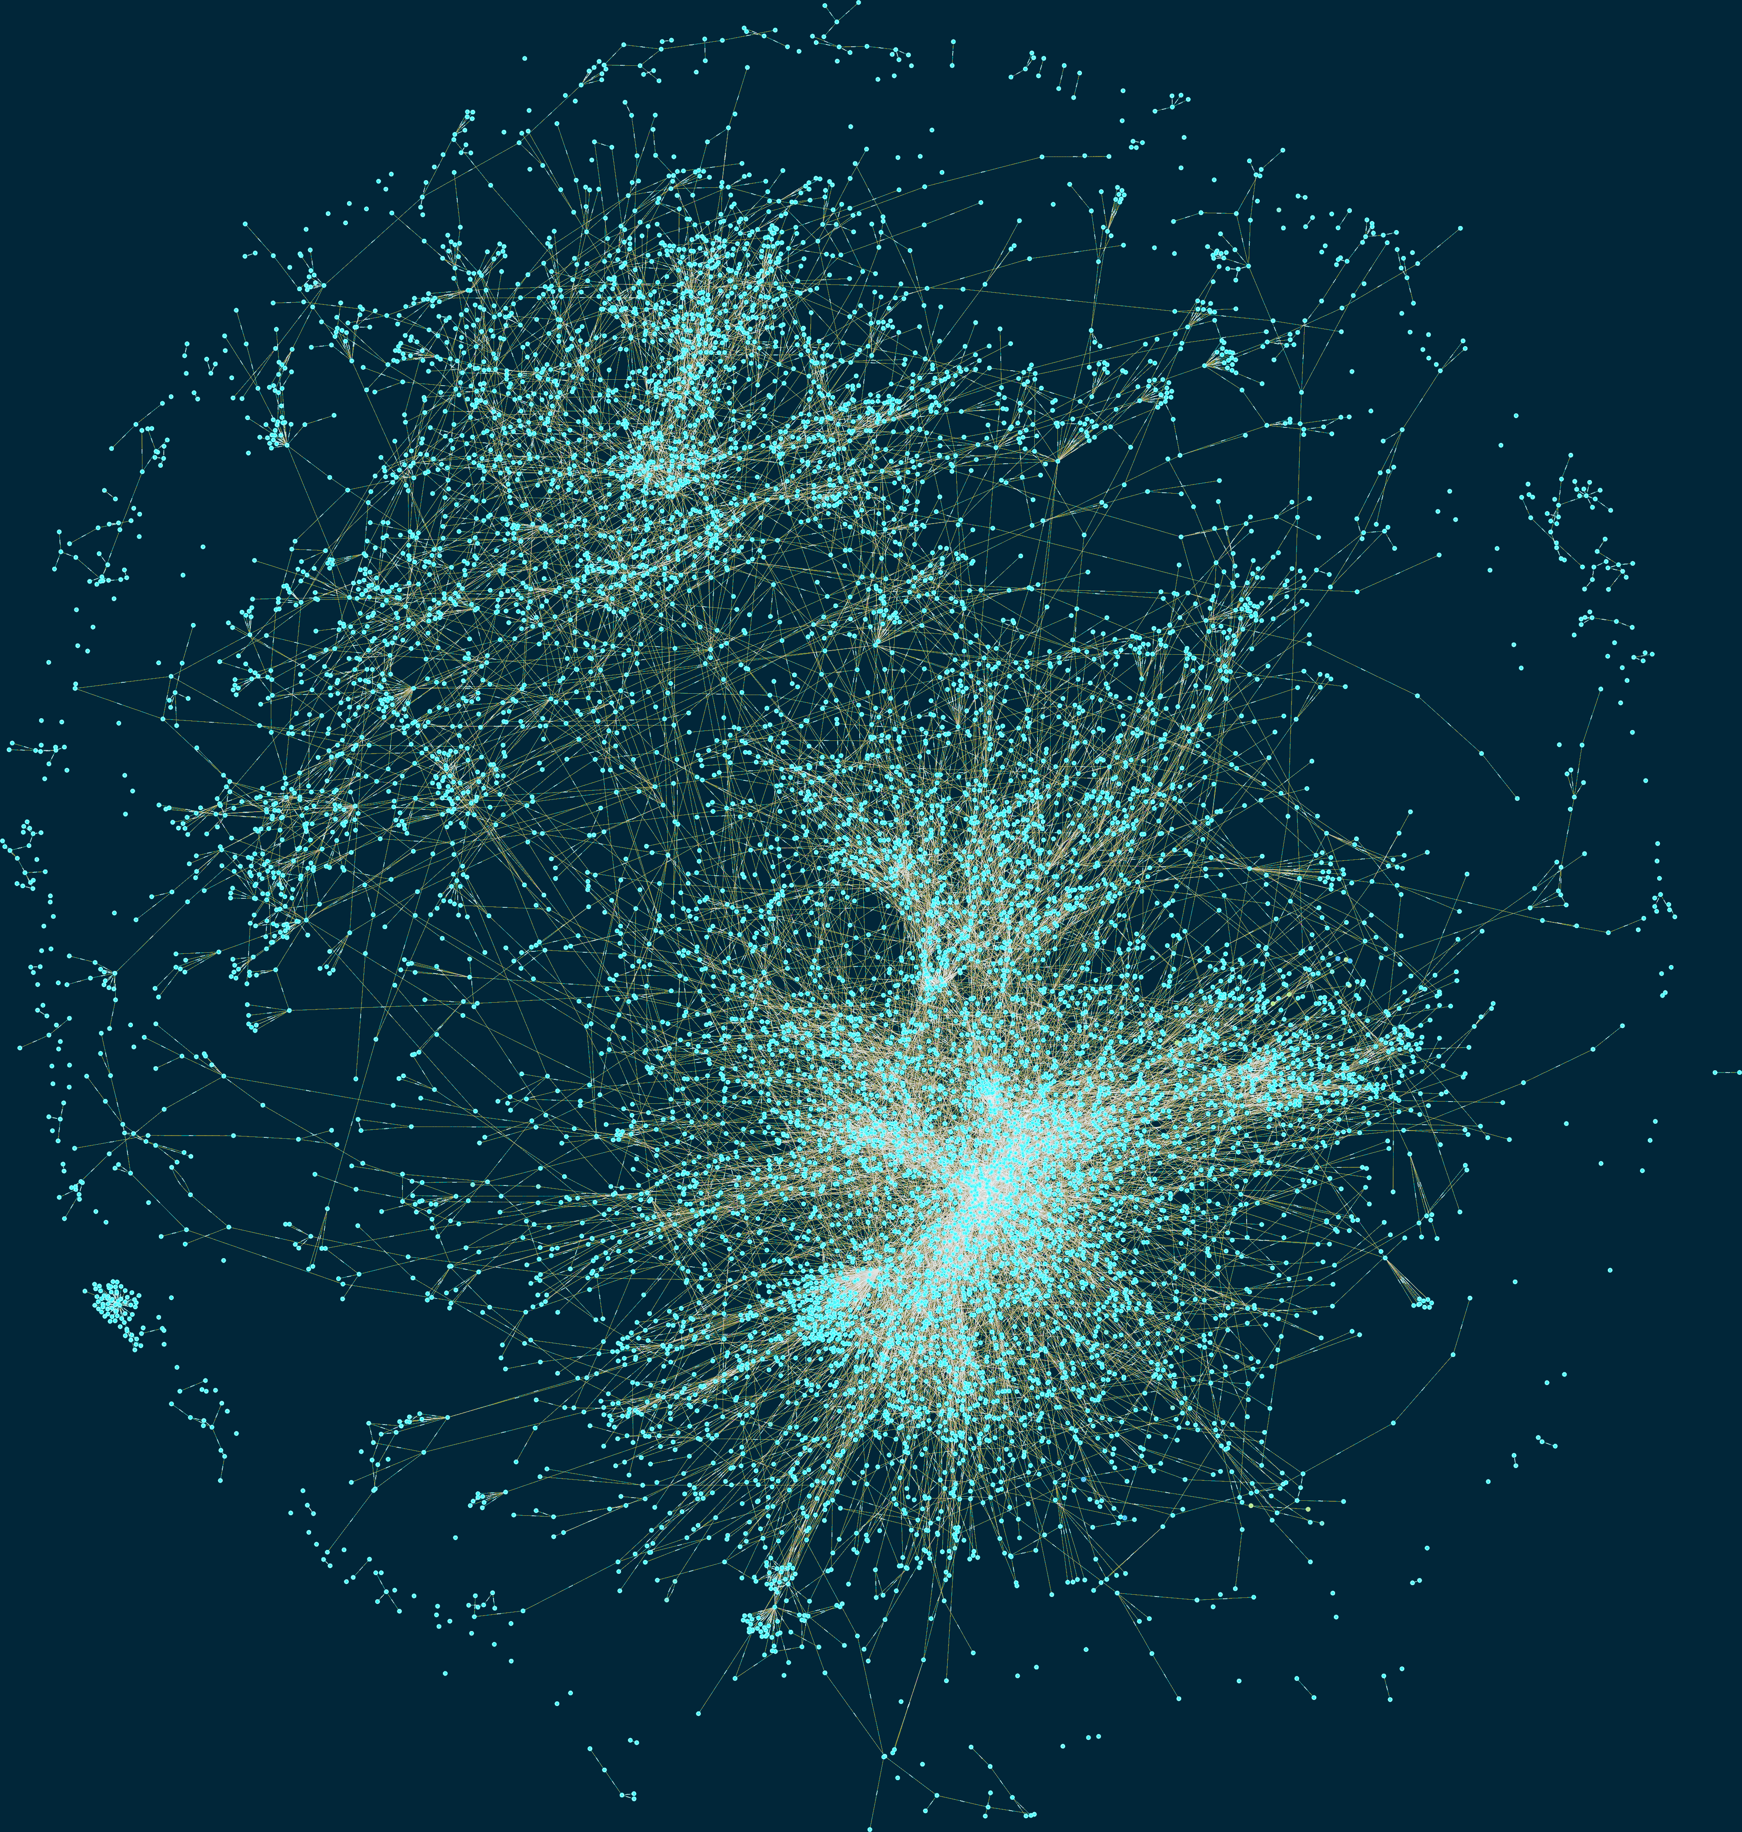
Empirical study (data collection)
9K artifacts
Diverse
Reused
Complex
723K dependency relationships
45K direct (6%)
180K inherited (25%)
498K transitive (69%)
3.6M artifacts in 2019.
27
Notes:
Based on this graph we selected a set of 9 thousand Maven artifacts as study subjects.
This selection took into account several criteria, such as:
Diversity: They belong to different maven projects
Reused: The subjects are used by at least one artifact through a direct dependency declaration
Comple: They contain class files, and have at least one direct dependency with compile scope
The selected 9 thousand Maven artifacts contain a total of 723 dependency relationships,
Of which 6% are direct
25% are inherited
And 69% are transitive
27

Slide 28
Result
9K artifacts and 723K dependencies
2.7% of direct dependencies are bloated
15% of inherited dependencies are bloated
57% of transitive dependencies are bloated
28
Notes:
This bar chart summarizes the results obtained.
Each bar represents the percentage of dependencies of each type (direct, inherited, and transitive) that are bloated, in blue, or used, in orange.
-The key results, from this figure, is that 2.7% of direct dependencies are bloated. This is surprising because those are dependencies explicitly declared in the pom of the Maven project, that are not necessary to build the project.
-15.1% of the inherited dependencies are bloated. This means that there is a lot of dependency bloat that is caused by the Maven inheritance mechanism, in which basically all the dependencies of a parent module are inherited by its children.
-On the other hand, 57% of the transitive dependencies are bloated. These are dependencies that are induced by direct dependencies, as a result of the Maven dependency resolution mechanism, but, they are not necessary, and therefore it is bloat
28

Slide 29
RQ: Do developers care about bloated dependencies?
29
Notes:
Do developers care about it?
29

Slide 30
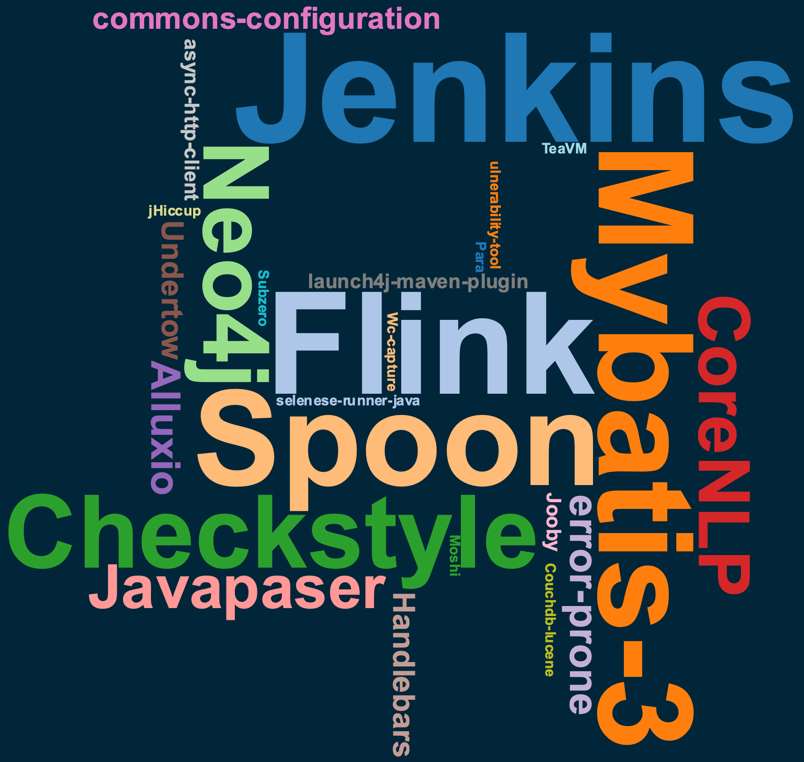
User study
30 software projects
Open source
Active
Popular
Build succesfuly with Maven
Contain dependencies
30
Notes:
To answer this question, we performed a user study.
-We selected 30 projects and used DepClean to detect bloated dependencies.
-For the selection of these projects, we follow several criteria, such as
-They must be open source
-Active on GitHub
-Popular, with at least 100 starts
-They build with Maven and contain dependencies
-This word cloud shows the selected projects. Most of them are well known by the Java community, such as Jenkins, Flink, Neo4j, Checkstyle
30

Slide 31
Result
30 pull requests in 30 notable open-source projects
Removed 140 bloated dependencies in 21 projects thanks to DepClean.
31
Notes:
In total, 140 dependencies were removed in 21 projects.
This result indicates that removing bloated dependencies is important for developers.
They are ready to take action, and also that if we submit more pull request proposing the removal of bloated dependencies, they are likely to be accepted by developers.
31

Slide 32
Example: Jenkins
jenkins-core
org.jvnet.hudson:jtidy (direct)
org.jenkins-ci:constant-pool-scanner (transitive)
net.i2p.crypto:eddsa (transitive)
jenkins-cli
commons-codec (direct)
https://github.com/jenkinsci/jenkins/pull/4378
32
Notes:
Let’s a example of a project that we analyze.
DepClean found bloated dependencies in the core module of Jenkins
One bloated direct, and two transitive
It also found a direct dependency bloated in the cli module of Jenkins
So, we submitted a pull request proposing the removal of these dependendencies.
32

Slide 33
Developers’ comments
jenkins-core
“Past experiences removing unused dependencies have consistently shown that some code will have depended on that inclusion and will be broken by it.”
33
Notes:
With respect to the bloated dependencies in jenkins-core. Developers were reluctant to remove them:
They said that past experiences removing unused dependencies have broken some clients.
They agree that these dependencies are not used, but they don’t want to remove them for compatibility reasons.
What we can learn from this case is that bloated dependencies should be removed as soon as they appear. Because otherwise some clients may depend on them and it will be more difficult to take action without breaking the clients
33

Slide 34
RQ: Why consider debloating?
34
Notes:
Do developers care about it?
34

Slide 35
Longitudinal study
435 projects
31 515 dependency tree versions
Do bloated dependencies stay bloated across time?
Do developers maintain dependencies that are bloated?
35
Notes:
Let’s a example of a project that we analyze.
DepClean found bloated dependencies in the core module of Jenkins
One bloated direct, and two transitive
It also found a direct dependency bloated in the cli module of Jenkins
So, we submitted a pull request proposing the removal of these dependendencies.
35

Slide 36
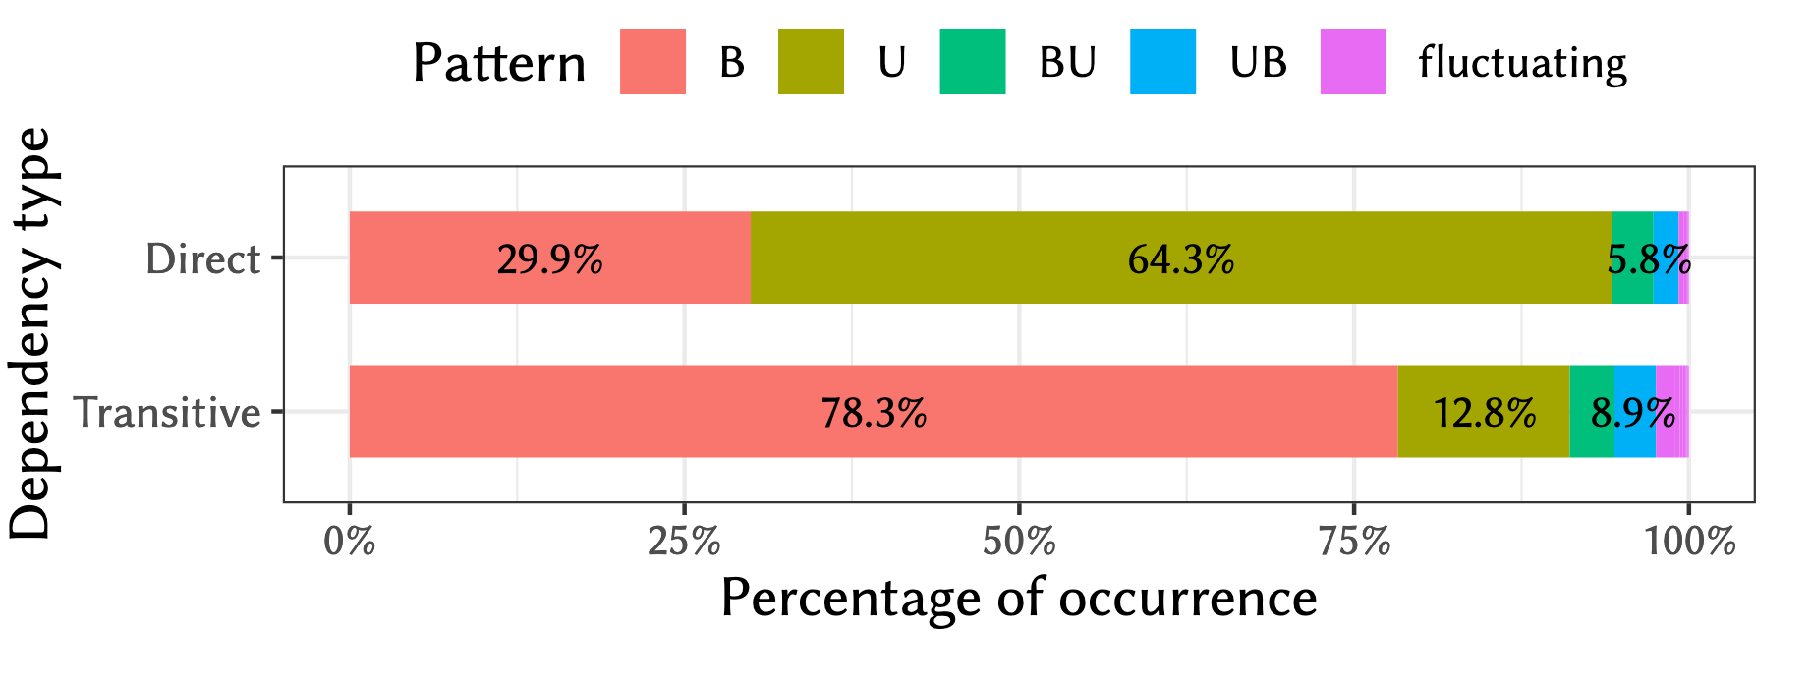
Result
Do bloated dependencies stay bloated across time?
36
Notes:
We compute the percentage of occurrence of each pattern with respect to the total.
We found that 64.3% of the direct dependencies are always used in the projects, whereas 29.9% of them are always bloated.
This means that most direct dependencies never change their status through the evolution of the software projects.
On the other hand, 78.3% of the transitive dependencies are bloated from the start, whereas 12.8% are always used.
This means that transitive dependencies also do not change their usage status over time.
36

Slide 37
Result
89% of bloated direct, and 93% of the transitive bloated dependencies remain bloated in all subsequent versions of the studied projects.
37
Notes:
89.2 % of bloated direct, and 93.3 % of the transitive bloated dependencies remain bloated in all subsequent versions of the studied projects.
This empirical evidence suggests that developers can safely take a debloating action when detecting bloated dependencies.
37

Slide 38

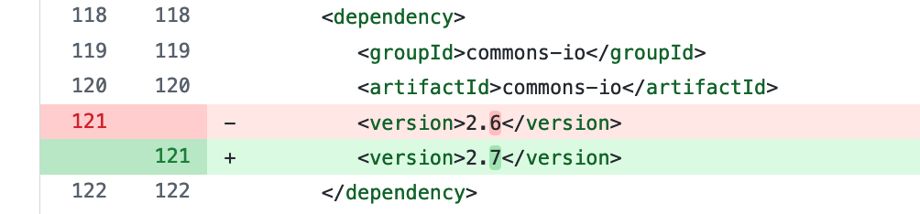
Longitudinal study
Do developers maintain dependencies that are bloated?
38
Notes:
To answer our third research question, we investigate whether or not developers maintain dependencies that are bloated.
We filter all the commits in our dataset that constitute dependency updates.
The figure shows an example of one of such commits.
In this case, a developer manually updates the dependency of Apache commons-io from version 2.6 to version 2.7.
38

Slide 39
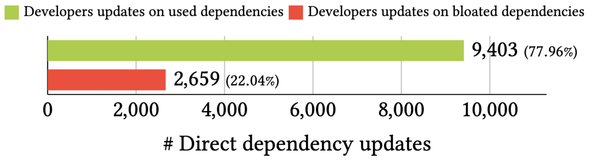
Result
Do developers maintain dependencies that are bloated?
39
Notes:
This plot presents the number of dependency updates on used and bloated dependencies made by developers.
As we can see, developers invest 22% of their dependency update efforts on bloated dependencies.
39

Slide 40
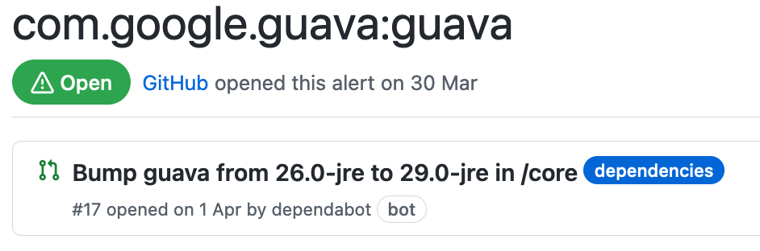

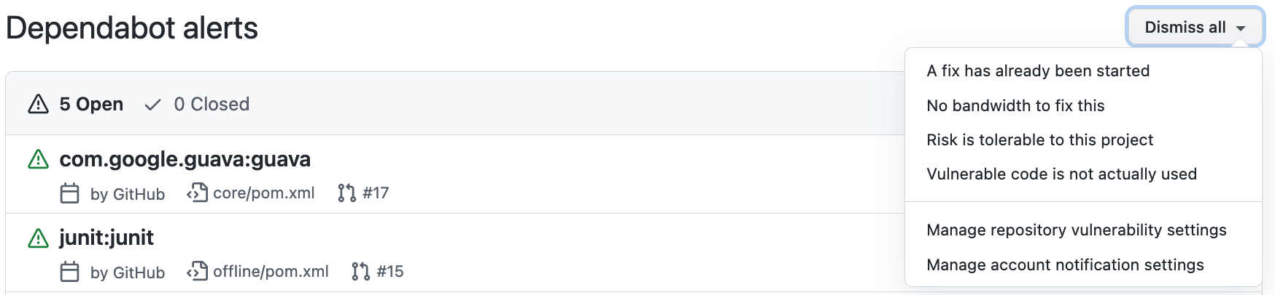
Longitudinal study
Do developers maintain dependencies that are bloated?
40
Notes:
During our analysis, we notice that many of the dependency updates were performed by Dependabot.
This is a software bot very active on GitHub that alerts developers about security issues related to their dependencies.
40

Slide 41
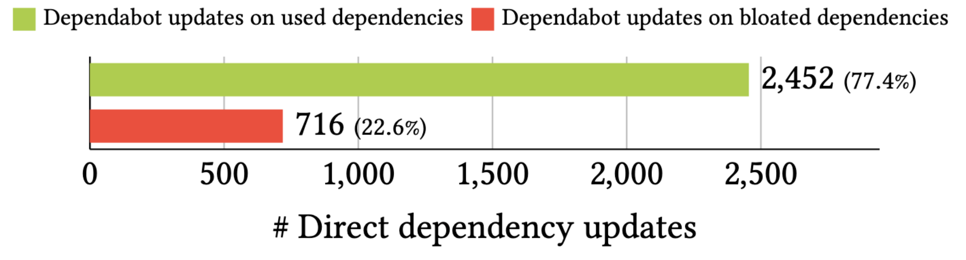
Result
Do developers maintain dependencies that are bloated?
41
Notes:
On the other hand, we observe that Dependabot suggests a similar ratio of updates on bloated dependencies.
This result indicates that Dependabot should improve the suggestions that it makes to developers to detect bloated dependencies and reduce the maintenance effort induced by software bloat.
41

Slide 42
Result
Bloated dependencies remain bloated over time.
Developers maintain dependencies that are bloated.
Bots suggest maintaining dependencies that are bloated.
42
Notes:
On the other hand, we observe that Dependabot suggests a similar ratio of updates on bloated dependencies.
This result indicates that Dependabot should improve the suggestions that it makes to developers to detect bloated dependencies and reduce the maintenance effort induced by software bloat.
42

Slide 43
Part #3: Debloating Java bytecode
[ Dynamic analysis]
43
Notes:
Let’s say that we have a project P.
In the pom.xml we declare three dependencies, A, B, and C. These are direct dependencies of project P.
But the dependency A also has other dependencies, D and E, and dependency C has a depenency F. D, E, and F are called transitive dependencies of project P.
On the other hand, this project P declares the module Q as his parent, and Q declares a direct dependency G. So, in this context G becomes an inherited dependency of project P.
In summary, we can distinguish three types of dependencies in the dependency tree of P: direct dependencies, transitive dependencies, and inherited dependencies.
43

Slide 44
Source code
import com.google.common.base.Joiner; import org.apache.spark.annotation.Private; @Private public class EnumUtil { public static <E extends Enum<E>> E parseIgnoreCase(Class<E> clz, String str) { E[] constants = clz.getEnumConstants(); if (str == null) { return null; } for (E e : constants) { if (e.name().equalsIgnoreCase(str)) { return e; } } throw new IllegalArgumentException( String.format("Illegal type='%s'. Supported type values: %s", str, Joiner.on(", ").join(constants))); } }
44
core/src/main/java/org/apache/spark/util/EnumUtil.java
Notes:
If we forget about the dependency tree structure for a moment and look at the bytecode calls made by the project P, we can see that there is a set of instructions in P that call another set of instructions in the dependency A. And this set of instructions in A calls another subset of the transitive dependency D.
Interestingly, we can also see that the depency F is is used by a subset of P.
So, in this context, the dependency tree of P is still the same but there are dependencies that are not needed.
P doesn’t need B, it does’t need C, E, or G.
We call these bloated dependencies, and we believe that they should be removed.
44

Slide 45
Bytecode
// class version 52.0 (52)
// access flags 0x21
public class org/apache/spark/util/EnumUtil {
// compiled from: EnumUtil.java
// access flags 0x9
// signature <E:Ljava/lang/Enum<TE;>;>(Ljava/lang/Class<TE;>;Ljava/lang/String;)TE;
// declaration: E parseIgnoreCase<E extends java.lang.Enum<E>>(java.lang.Class<E>, java.lang.String)
public static parseIgnoreCase(Ljava/lang/Class;Ljava/lang/String;)Ljava/lang/Enum;
. . .
L9
LINENUMBER 35 L9
INVOKESTATIC com/google/common/base/Joiner.on (Ljava/lang/String;)Lcom/google/common/base/Joiner;
ALOAD 2
INVOKEVIRTUAL com/google/common/base/Joiner.join ([Ljava/lang/Object;)Ljava/lang/String;
AASTORE
. . .
45
target/classes/org/apache/spark/util/EnumUtil.class
Notes:
If we forget about the dependency tree structure for a moment and look at the bytecode calls made by the project P, we can see that there is a set of instructions in P that call another set of instructions in the dependency A. And this set of instructions in A calls another subset of the transitive dependency D.
Interestingly, we can also see that the depency F is is used by a subset of P.
So, in this context, the dependency tree of P is still the same but there are dependencies that are not needed.
P doesn’t need B, it does’t need C, E, or G.
We call these bloated dependencies, and we believe that they should be removed.
45

Slide 46
Dynamic analysis
P
A
D
F
Notes:
What you are seeing now is what we can get so far if we use state-of-the-art software debloating techniques that rely on static analysis.

Slide 47
Dynamic analysis
Input
P
A
D
F
Notes:
Now let’s suppose that there is an input that executes the path that goes from P to A, and D.

Slide 48
Dynamic analysis
Input
P
A
D
F
Notes:
This makes part of the other components in P, as well as F unnecessary to satisfy the input.

Slide 49
Dynamic analysis
Input
P
A
D
49
Notes:
So we can remove them.

Slide 50
Dynamic analysis
Input
P
A
D
50
Notes:
So we can remove them.

Slide 51
Dynamic analysis
Input
51
Notes:
And this is what we obtain when using software debloating techniques that rely on dynamic analysis.

Slide 52
Dynamic analysis
52
Notes:
And we collect the used components.

Slide 53
Dynamic analysis
53
Notes:
Package them.

Slide 54
Dynamic analysis
Input
P’
54
Notes:
And then build a single artifact P’ that only contains the necessary parts to successfully execute the application for the given input.

Slide 55
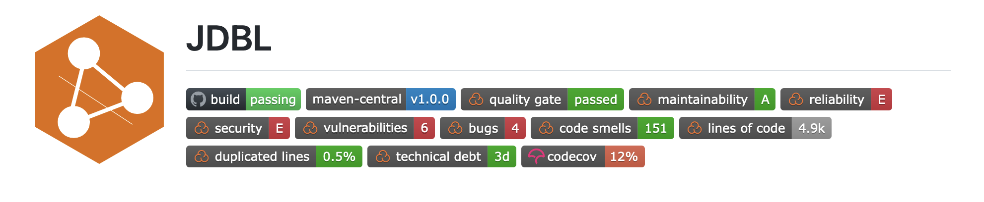
JDBL
P
P’
Relies on code-coverage tools to collect bytecode usage information at runtime.
Automatically removes unused methods, classes, and dependencies in Java projects.
Open source (https://github.com/castor-software/jdbl)
Notes:
Well, in this work, we have built such a tool that automatically transforms a project P into a debloated version that only contains the parts of P that are necessary to execute certain workload.
Our tool is called JDBL and it relies on existing code-coverage tools to collect bytecode usage information at runtime.
JDBL is capable of removing methods, classes, and dependencies in Java projects that build with Maven.

Slide 56
Debloating with JDBL
Input
Output
Project
1
2
3
JAR
Collect
Remove
Validate
Workload
JDBL
56
Notes:
In essence, JDBL works in three phases.
It receives as input a Java project and a workload that executes some part of the project.
In the first phase, JDBL uses code coverage tools to collect bytecode usage information.
Then, in the second phase, JDBL removes the unnecesary bytecode from the project and its dependencies
Finally, in the third phase, JDBL validates the debloating by executing the project against the same workload.
If the result is as expected, then the project is packaged as a debloated JAR file.

Slide 57


Experiment (debloating libraries)
P = Original library
P’ = Debloated library
P
Build
success?
P’
JAR
exists?
P’
Test suite
pass?
The project build fails
JDBL does not produces a debloated JAR
Debloated artifact does not preserves the behaviour
https://github.com/castor-software/jdbl-experiments
500 single-module Java Maven projects
Commits on the POM files
Notes:
We performed experiments to evaluate JDBL.
For our first experiment, consider a popular Java library P that builds successfully.
Then we debloat P and obtain P’.
We check if JDBL produces a debloated JAR.
If that’s the case, then we check if the JAR preserves the original behaviour using the test suite.
If all the tests pass, then we can say that the debloating was successful.

Slide 58
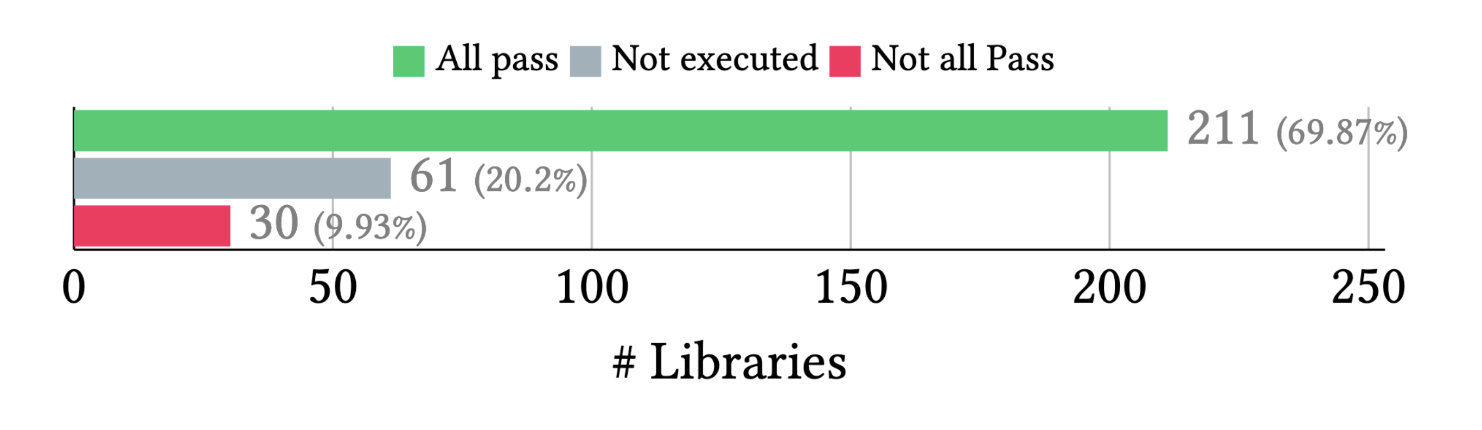
Result (debloating libraries)
Notes:
We followed this approach and obtained a debloated JAR for 302 libraries, and from these libraries a total of 211 pass all the test.
This represents almost a 70% of the libraries.
This behavioral assessment of coverage-based debloating demonstrates that JDBL preserves a large majority of the libraries’ behavior, which is essential to meet the expectations of their clients.

Slide 59
Result (debloating libraries)
 | Removed*
Methods Classes Dependencies | 59% 60% 20%
*211 debloated libraries
Notes:
We measure the number of methods, classes and dependencies removed in the successfully debloated libraries.
JDBL removes 59% of methods, 60% of classes, and 20% of dependencies in our dataset.
This result confirms the relevance of the coverage-based debloating approach for reducing the unnecessary bytecode of Java projects, while preserving their correctness.

Slide 60
Experiment (impact on clients)
C_{P} = Client of original library P
C_{P’} = Client of debloated library P’
C_{P}
Build success?
C_{P’}
Client compiles?
Test suite pass?
The client build
fails
The client compilation is broken due to the debloated library
The client does not preserves its behaviour
https://github.com/castor-software/jdbl-experiments
Notes:
We also focus on evaluating the impact of debloating on the clients that reuse the debloated libraries.
For a client C that uses the original library P and builds successfully, we replace P by its debloated version P’ in order to investigate if the client still compiles and if the tests suite still passes.
If both are successful then we can say that the client can use the debloated version of the library.

Slide 61
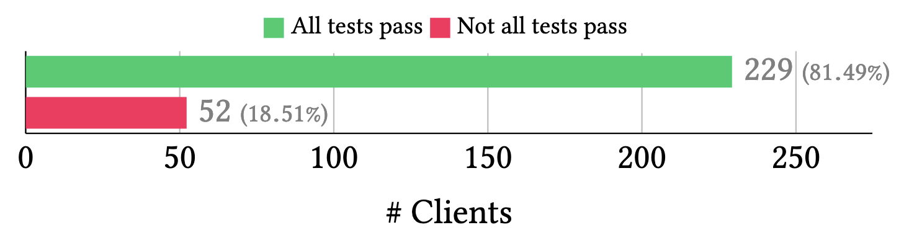
Result (impact on clients)
Notes:
Furthermore, from these clients, 81% of them pass all the tests.
This means that JDBL preserves the behaviour of most of the clients.
We also found that 99.1% of the test failures are due to a missing class or method, which can be easily located and fixed.
This experiment shows that the risks of removing code in software libraries are limited for their clients.

Slide 62
Part #4: Lessons learned
62
Notes:
Let’s say that we have a project P.
In the pom.xml we declare three dependencies, A, B, and C. These are direct dependencies of project P.
But the dependency A also has other dependencies, D and E, and dependency C has a depenency F. D, E, and F are called transitive dependencies of project P.
On the other hand, this project P declares the module Q as his parent, and Q declares a direct dependency G. So, in this context G becomes an inherited dependency of project P.
In summary, we can distinguish three types of dependencies in the dependency tree of P: direct dependencies, transitive dependencies, and inherited dependencies.
62

Slide 63
Lessons learned
Debloating Java dependencies is a relevant problem.
Debloating Java bytecode is challenging.
Debloating real-world applications, automatically, is not the same than debloating hand-picked projects.
Guaranteeing the safety of the debloating procedure is difficult.
63
Notes:
Let’s a example of a project that we analyze.
DepClean found bloated dependencies in the core module of Jenkins
One bloated direct, and two transitive
It also found a direct dependency bloated in the cli module of Jenkins
So, we submitted a pull request proposing the removal of these dependendencies.
63

Slide 64
Part #5: Conclusion
64
Notes:
Let’s say that we have a project P.
In the pom.xml we declare three dependencies, A, B, and C. These are direct dependencies of project P.
But the dependency A also has other dependencies, D and E, and dependency C has a depenency F. D, E, and F are called transitive dependencies of project P.
On the other hand, this project P declares the module Q as his parent, and Q declares a direct dependency G. So, in this context G becomes an inherited dependency of project P.
In summary, we can distinguish three types of dependencies in the dependency tree of P: direct dependencies, transitive dependencies, and inherited dependencies.
64

Slide 65
Conclusion
Maven dependencies are bloated as a consequence of:
Transitive dependencies
Heritage mechanism of multi-module projects
Limited engineering of configuration files (pom.xml)
Software developers care about bloated dependencies.
Coverage-based debloating is a promising technique that advances the state-of-the-art of Java bytecode debloating.
65
Notes:
Let’s a example of a project that we analyze.
DepClean found bloated dependencies in the core module of Jenkins
One bloated direct, and two transitive
It also found a direct dependency bloated in the cli module of Jenkins
So, we submitted a pull request proposing the removal of these dependendencies.
65

Slide 66
Part #6: Future work
66
Notes:
Let’s say that we have a project P.
In the pom.xml we declare three dependencies, A, B, and C. These are direct dependencies of project P.
But the dependency A also has other dependencies, D and E, and dependency C has a depenency F. D, E, and F are called transitive dependencies of project P.
On the other hand, this project P declares the module Q as his parent, and Q declares a direct dependency G. So, in this context G becomes an inherited dependency of project P.
In summary, we can distinguish three types of dependencies in the dependency tree of P: direct dependencies, transitive dependencies, and inherited dependencies.
66

Slide 67
Future work
Using debloating to specialize and diversify the software supply chain of third-party dependencies.
Variants
D₁
Original
P
D
D₂
D₃
67
Notes:
Let’s a example of a project that we analyze.
DepClean found bloated dependencies in the core module of Jenkins
One bloated direct, and two transitive
It also found a direct dependency bloated in the cli module of Jenkins
So, we submitted a pull request proposing the removal of these dependendencies.
67

Slide 68
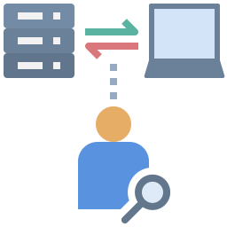
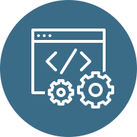


Future work
Debloating applications with respect to usage profiles collected in production environments.
Variants
D1
P₁
P₂
D2
P₃
D3
68
Notes:
Let’s a example of a project that we analyze.
DepClean found bloated dependencies in the core module of Jenkins
One bloated direct, and two transitive
It also found a direct dependency bloated in the cli module of Jenkins
So, we submitted a pull request proposing the removal of these dependendencies.
68

Slide 69
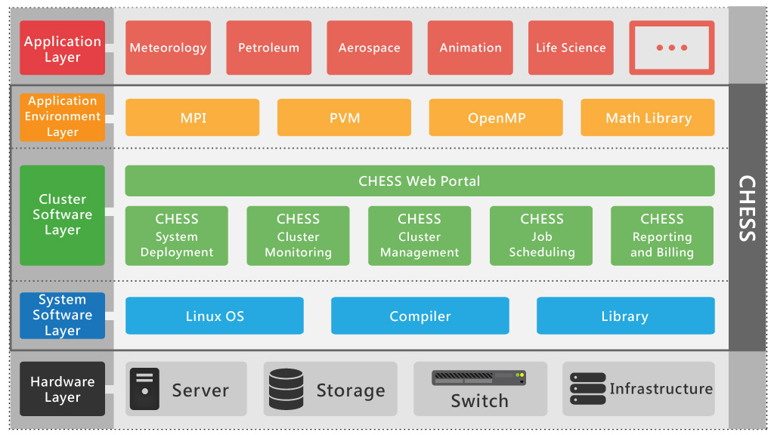
Future work
Extending the debloating techniques to cover other layers of the software stack.
Specialized App.
Debloated Env.
Debloated Infrastructure
Slim OS
Dedicated Hardware
debloating
69
Notes:
Let’s a example of a project that we analyze.
DepClean found bloated dependencies in the core module of Jenkins
One bloated direct, and two transitive
It also found a direct dependency bloated in the cli module of Jenkins
So, we submitted a pull request proposing the removal of these dependendencies.
69

Slide 70

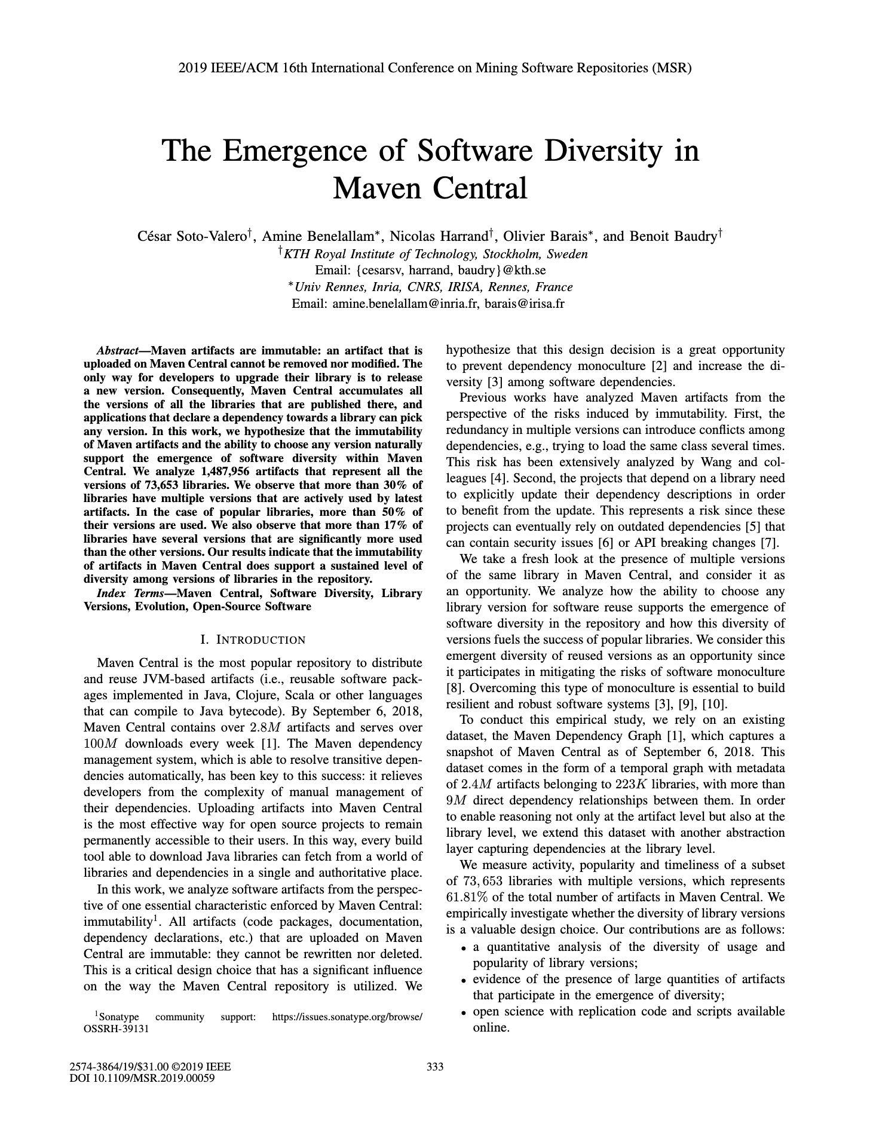
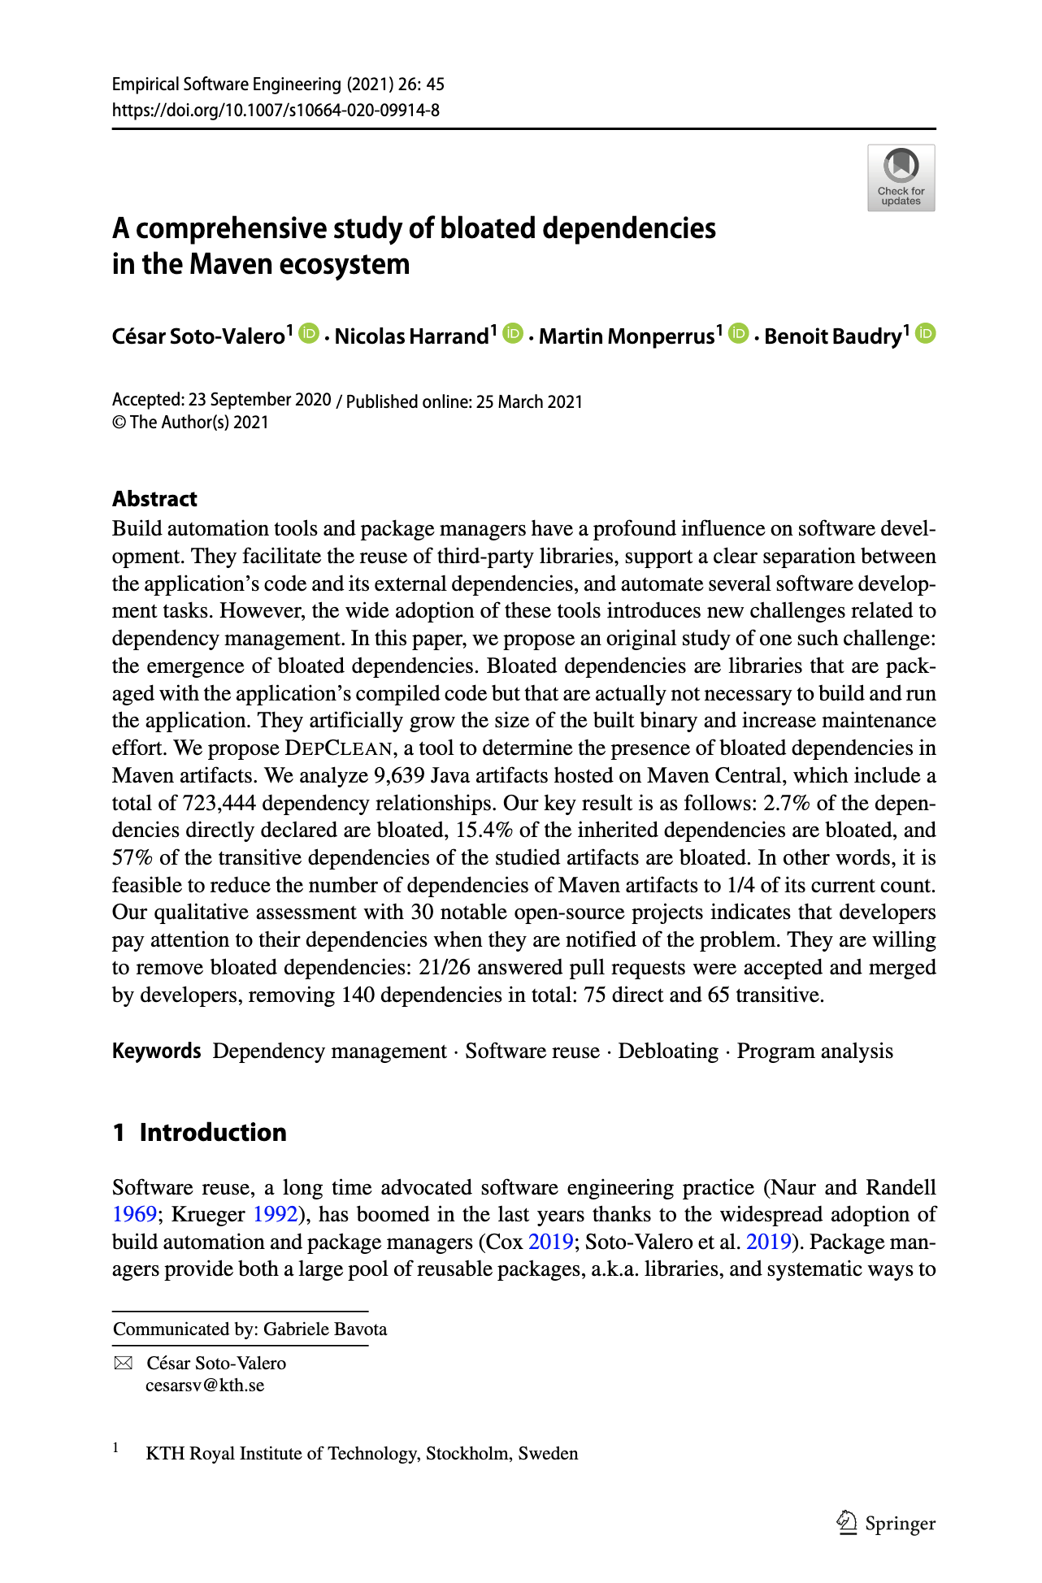
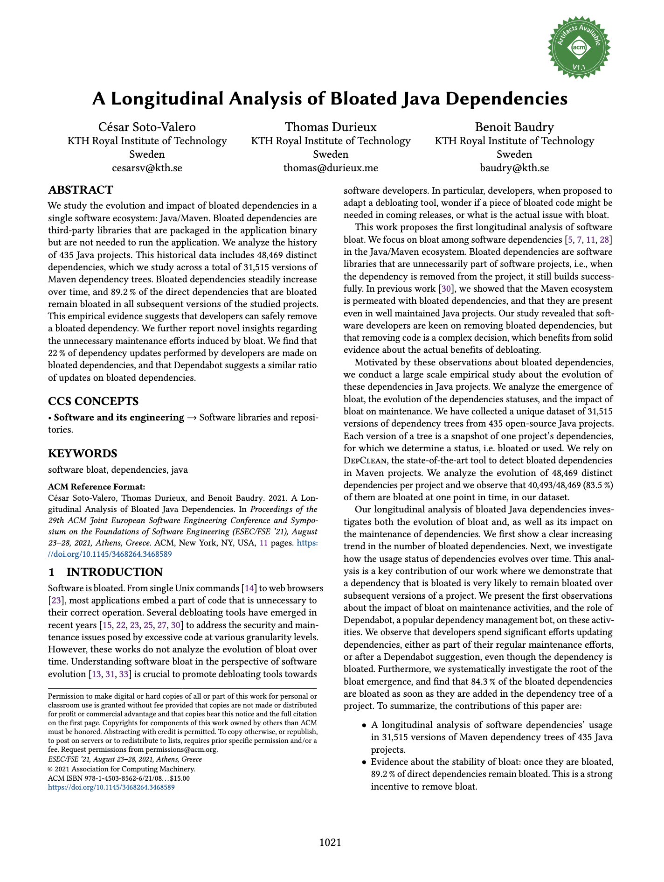
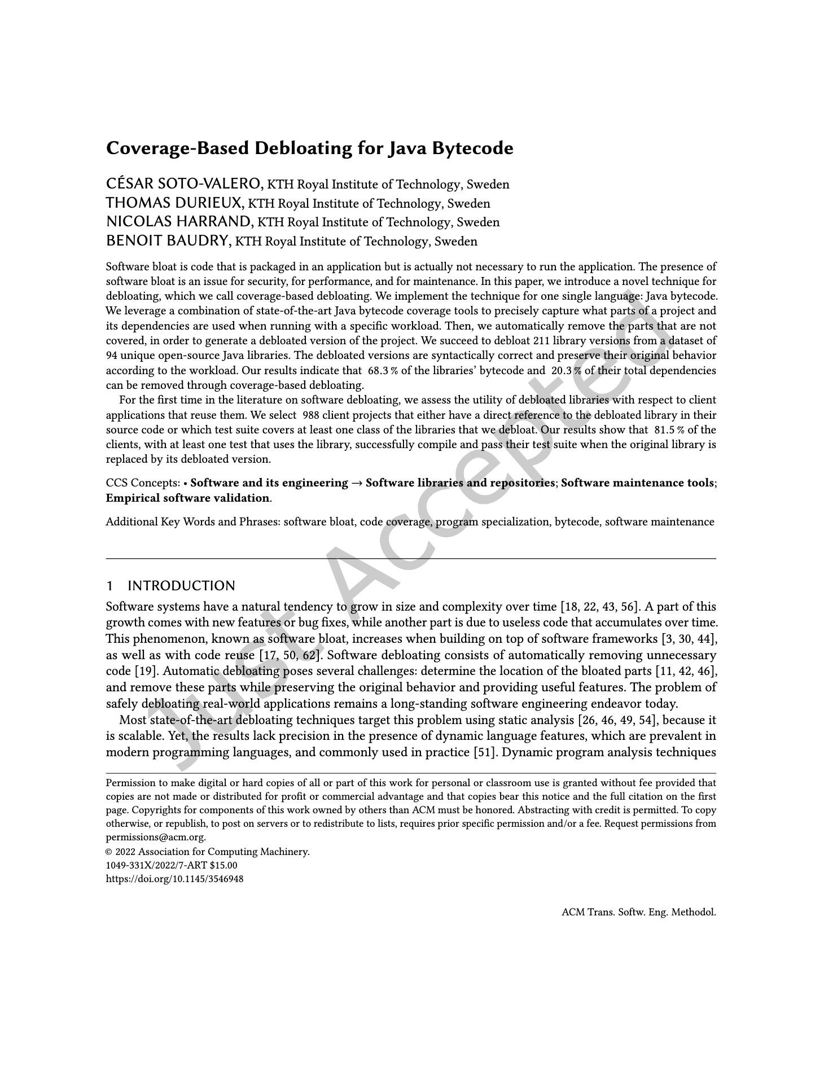

Publications
The Multibillion Dollar Software Supply Chain of Ethereum. IEEE Computer, 2022.
* Coverage-Based Debloating for Java Bytecode. TOSEM, 2022.
* A Comprehensive Study of Bloated Dependencies in the Maven Ecosystem. EMSE, 2021.
* A Longitudinal Analysis of Bloated Java Dependencies. ESEC/FSE, 2021.
The Emergence of Software Diversity in Maven Central. MSR, 2019.
cesarsv@kth.se
Notes:
Let’s a example of a project that we analyze.
DepClean found bloated dependencies in the core module of Jenkins
One bloated direct, and two transitive
It also found a direct dependency bloated in the cli module of Jenkins
So, we submitted a pull request proposing the removal of these dependendencies.
70

Slide 71
Objective
Q
P
G
P
debloating
A
B
C
A
F
D
E
F
D
DepClean reduces the size of the dependency tree by debloating unused dependencies, automatically.
71
Notes:
To sum up, the main objective of DepClean is, for a given Maven project P, to debloat its dependency tree and produce a version of it without bloated dependencies.
71

Slide 72
The Maven ecosystem is big!
We counted 3.6M artifacts in 2019.
72
“The Maven Dependency Graph: a Temporal Graph-based Representation of Maven Central” (published in MSR’19)
Notes:
Well, one thing that we know is that it is big.
Two years ago, we performed an study with the objective of constructing the most precise representation of the dependency relationships between the artifacts in Maven Central.
What you see is part of the Maven Dependency Graph that we built.
- It contained 3.6 million artifacts in 2019.
72

Slide 73

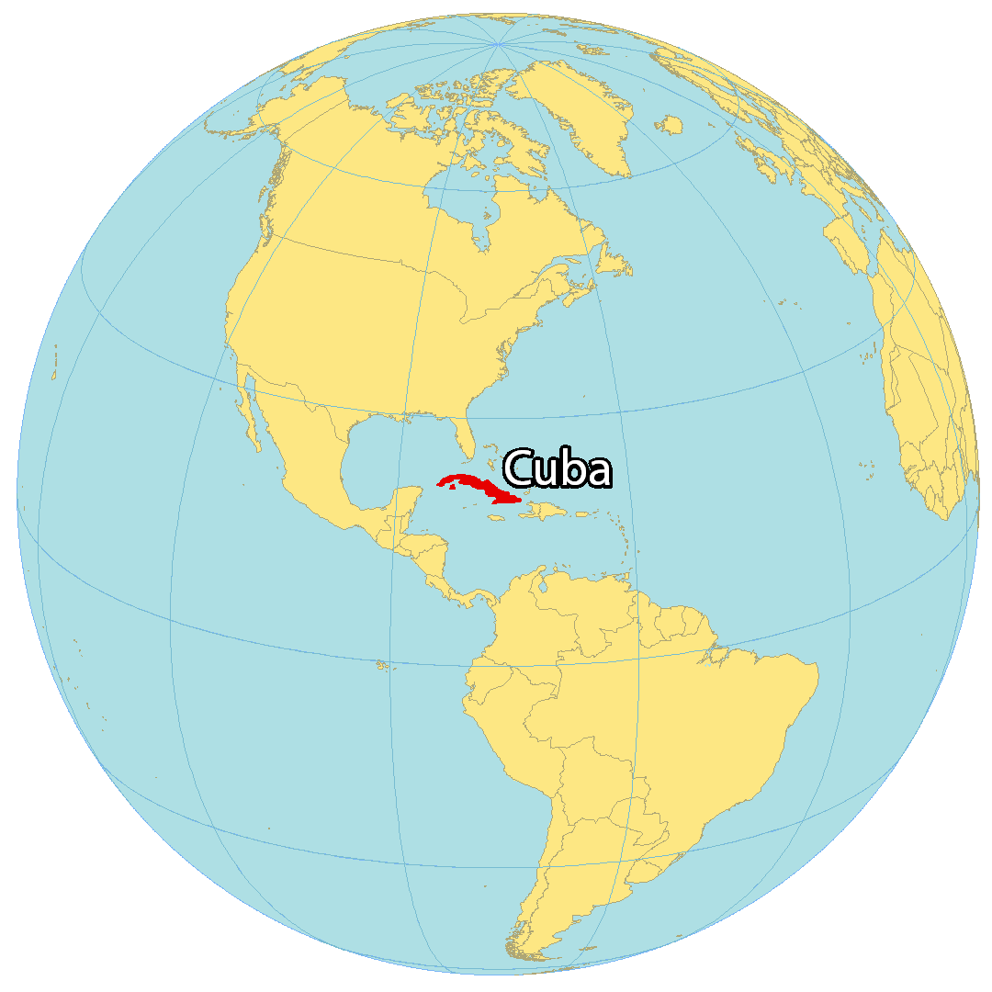
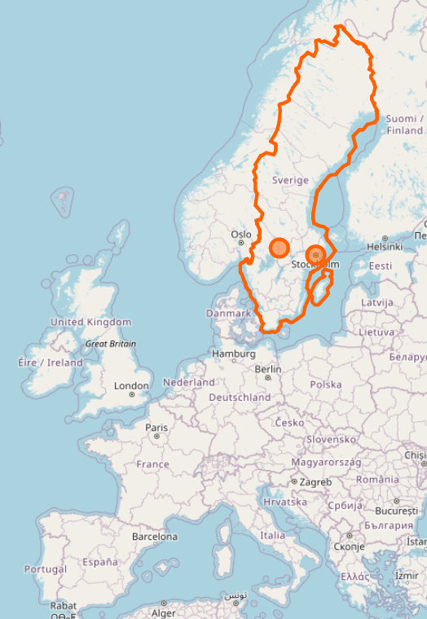

$ whoami
Moved from Cuba to Sweden with:
BSc and MSc in Computer Science
PhD student at KTH since 2018 working on:
Automatic software debloating
Software dependencies
Software diversity
Enthusiastic techy guy ;)
https://www.cesarsotovalero.net

